Slide 1
FLOWERS…FLOWERs… EVERYWHERE!
IC VIA ORMEA
PLESSO VIA CORNELIA 43
CLASSE II SEZ A
ETWINNING PROJECT 2016

Slide 2
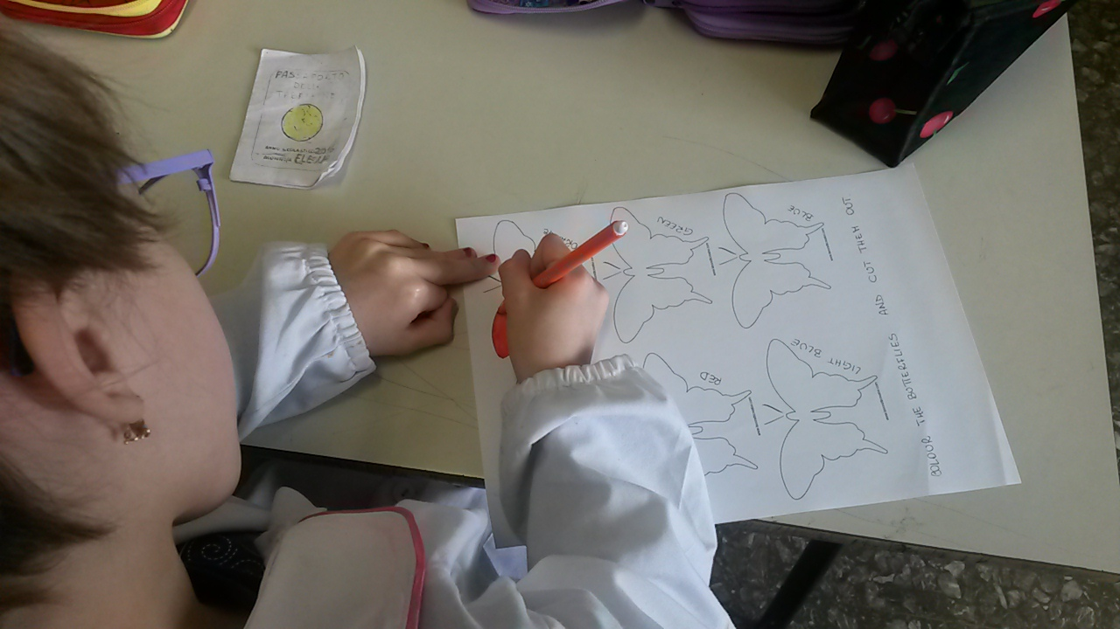
COLOUR THE BUTTERFLIES RED, YELLOW, GREEN, BLUE, PURPLE AND ORANGE THEN CUT THEM OUT.

Slide 3
LET’S DO IT!

Slide 4
MAKE FLOWERS WITH PLASTIC GLASSES AND STRAWS. STICK THEM ON A WALL PAPER.

Slide 5
STICK THE BUTTERFLIES LIKE A RAINBOW

Slide 6
WELCOME BACK SPRING!

